Slide 1
GIT BRANCHING MODEL

Slide 2




Slide 3
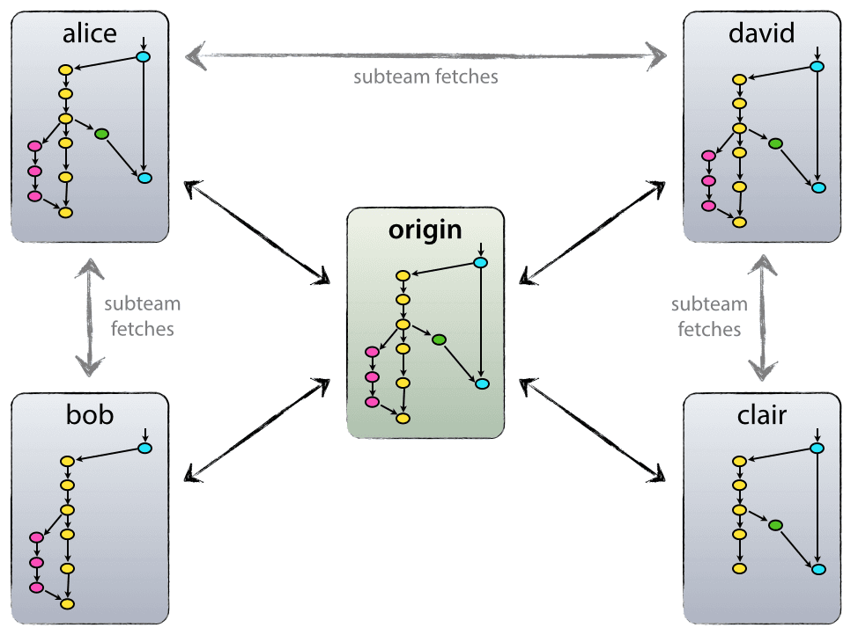
DESCENTRALIZADO PERO CENTRALIZADO

Slide 4
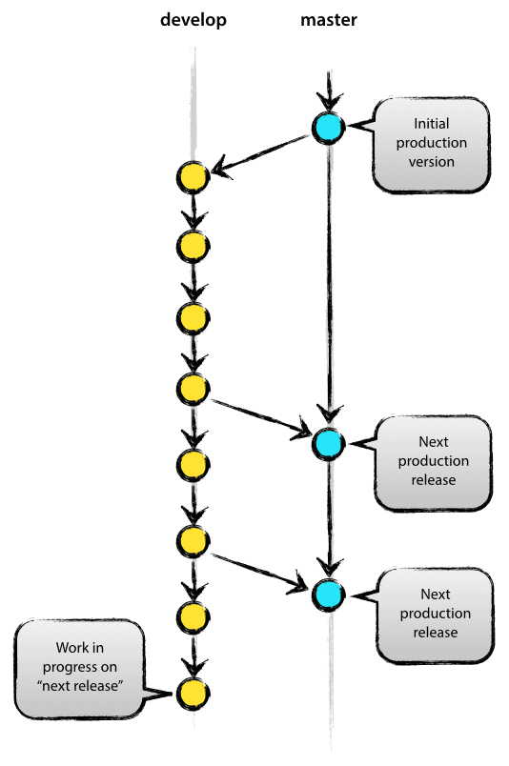
The MAIN BRANCHES
master
develop

Slide 5
SUPPORTING BRANCHES
Feature branches
Release branches
Hotfix branches

Slide 6
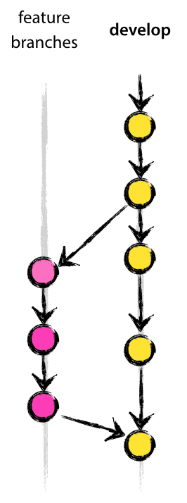
FEATURE BRANCHES
Origen: Develop
Objetivo: Develop
Convención de nombre: Cualquiera excepto master, develop, release-*, Hotfix-*
$ git checkout -b myfeature develop
Switched to a new branch "myfeature"
$ git checkout develop
Switched to branch 'develop’
$ git merge --no-ff myfeature
Updating ea1b82a..05e9557 (Summary of changes)
$ git branch -d myfeature
Deleted branch myfeature (was 05e9557).
$ git push origin develop

Slide 7
RELEASE BRANCHES
Origen: Develop
Objetivo: Develop y/o Master
Convención de nombre: release-*,
$ git checkout -b release-1.2 develop
Switched to a new branch "release-1.2"
$ ./bump-version.sh 1.2 Files modified successfully, version bumped to 1.2.
$ git commit -a -m "Bumped version number to 1.2" [release-1.2 74d9424] Bumped version number to 1.2 1 files changed, 1 insertions(+), 1 deletions(-)
$ git checkout master
Switched to branch 'master’
$ git merge --no-ff release-1.2
Merge made by recursive. (Summary of changes)
$ git tag -a 1.2
$ git checkout develop
Switched to branch 'develop’
$ git merge --no-ff release-1.2
Merge made by recursive. (Summary of changes)

Slide 8
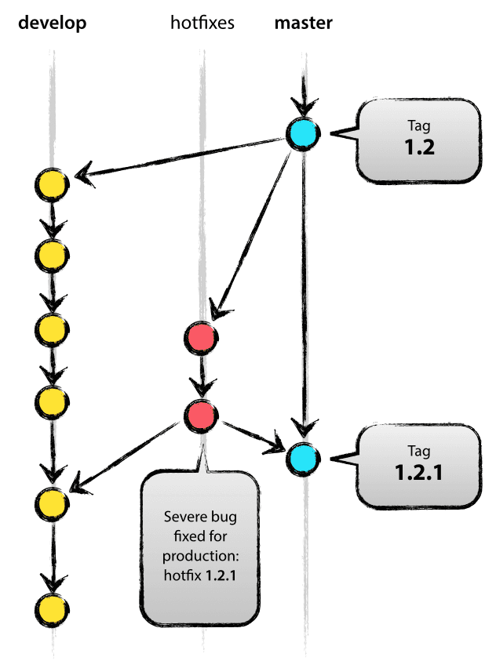
HOTFIX BRANCHES
Origen: Develop
Objetivo: Develop y Master
Convención de nombre: Cualquiera excepto master, develop, release-*, Hotfix-*
$ git checkout -b hotfix-1.2.1 master
Switched to a new branch "hotfix-1.2.1"
$ ./bump-version.sh 1.2.1
Files modified successfully, version bumped to 1.2.1.
$ git commit -a -m "Bumped version number to 1.2.1"
[hotfix-1.2.1 41e61bb] Bumped version number to 1.2.1 1 files changed, 1 insertions(+), 1 deletions(-)
$ git checkout master Switched to branch 'master’
$ git merge --no-ff hotfix-1.2.1 Merge made by recursive. (Summary of changes)
$ git tag -a 1.2.1
$ git checkout develop Switched to branch 'develop’
$ git merge --no-ff hotfix-1.2.1 Merge made by recursive. (Summary of changes)

Slide 9
REFERENCIAS
https://nvie.com/posts/a-successful-git-branching-model/

